Slide 1
12
Graphics and Java 2D™

Slide 2
One picture is worth ten thousand words.
Chinese proverb
Treat nature in terms of the cylinder, the sphere, the cone, all in perspective.
Paul Cézanne
Colors, like features, follow the changes of the emotions.
Pablo Picasso
Nothing ever becomes real till it is experienced—even a proverb is no proverb to you till your life has illustrated it.
John Keats

Slide 3
OBJECTIVES
In this chapter you will learn:
To understand graphics contexts and graphics objects.
To manipulate colors.
To manipulate fonts.
To use methods of class Graphics to draw lines, rectangles, rectangles with rounded corners, three-dimensional rectangles, ovals, arcs and polygons.
To use methods of class Graphics2D from the Java 2D API to draw lines, rectangles, rectangles with rounded corners, ellipses, arcs and general paths.
To specify Paint and Stroke characteristics of shapes displayed with Graphics2D.

Slide 4
12.1 Introduction
12.2 Graphics Contexts and Graphics Objects
12.3 Color Control
12.4 Font Control
12.5 Drawing Lines, Rectangles and Ovals
12.6 Drawing Arcs
12.7 Drawing Polygons and Polylines
12.8 Java 2D API
12.9 Wrap-Up

Slide 5
12.1 Introduction
Java contains support for graphics that enable programmers to visually enhance applications
Java contains many more sophisticated drawing capabilities as part of the Java 2D API
Classes
Color
Font, FontMetrics
Graphics2D
Polygon
BasicStroke
GradientPaint, TexturePaint
Java 2D shape classes

Slide 6
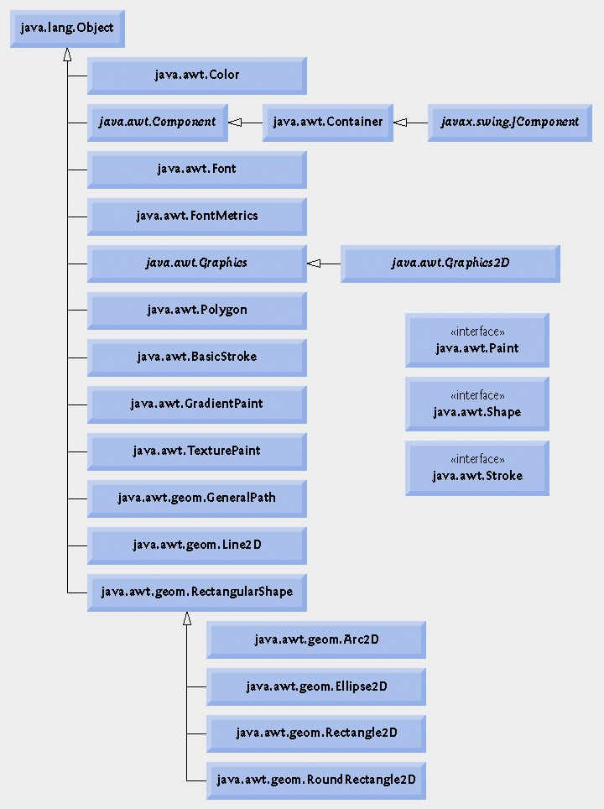
Fig. 12.1 | Classes and interfaces used in this chapter from Java’s original graphics capabilities and from the Java 2D API. [Note: Class Object appears here because it is the superclass of the Java class hierarchy.]

Slide 7
12.1 Introduction
Java coordinate system
Upper-left corner of a GUI component has the coordinates (0, 0)
Contains x-coordinate (horizontal coordinate) - horizontal distance moving right from the left of the screen
Contains y-coordinate (vertical coordinate) - vertical distance moving down from the top of the screen
Coordinate units are measured in pixels. A pixel is a display monitor’s smallest unit of resolution.

Slide 8
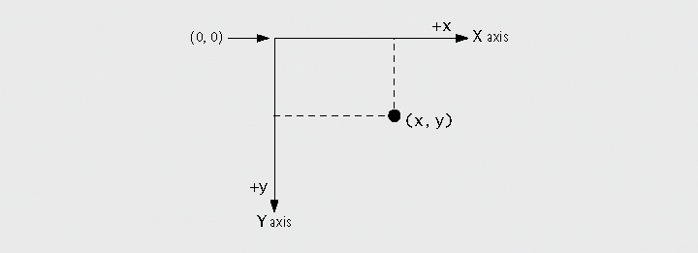
Fig. 12.2 | Java coordinate system. Units are measured in pixels.

Slide 9
Portability Tip 12.1
Different display monitors have different resolutions (i.e., the density of the pixels varies). This can cause graphics to appear to be different sizes on different monitors or on the same monitor with different settings.

Slide 10
12.2 Graphics Contexts and Graphics Objects
A Java graphics context enables drawing on the screen
Class Graphics
Manages a graphics context and draws pixels on the screen
An abstract class – contributes to Java’s portability
Method paintComponent
Used to draw graphics
Member of class JComponent, subclass of Component
Graphics object passed to paintComponent by the system when a lightweight Swing component needs to be repainted
If programmer needs to have paintComponent execute, a call is made to method repaint

Slide 11
12.3 Color Control
Class Color declares methods and constants for manipulating colors in a Java program
Every color is created from a red, a green and a blue component – RGB values

Slide 12
Fig. 12.3 | Color constants and their RGB values.

Slide 13
Fig. 12.4 | Color methods and color-related Graphics methods.

Slide 14
Method paintComponent paints JPanel
Set current drawing color with method setColor
Draw filled rectangle using current color
Draw text value of current color
Set current drawing color, specify float arguments to Color constructor
Set current drawing color using Color constant

Slide 15
Retrieving RGB values using methods getRed, getGreen and getBlue

Slide 16
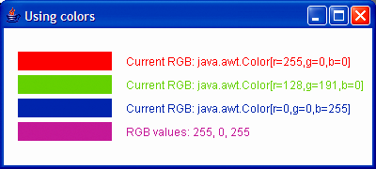

Slide 17
Look-and-Feel Observation 12.1
Everyone perceives colors differently. Choose your colors carefully to ensure that your application is readable. Try to avoid using many different colors in close proximity.

Slide 18
Software Engineering Observation 12.1
To change the color, you must create a new Color object (or use one of the predeclared Color constants). Like String objects, Color objects are immutable (not modifiable).

Slide 19
12.3 Color Control
JColorChooser GUI component enables application users to select colors
Method showDialog creates a JColorChooser object, attaches it to a dialog box and displays the dialog
Modal dialog
Allows the user to select a color from a variety of color swatches
Tabs – Swatches, HSB and RGB

Slide 20
Import JColorChooser class

Slide 21
Display JColorChooser dialog
Reference to parent component
Title bar text
Initial selected color
Change background color of JPanel

Slide 23
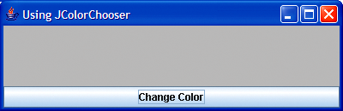
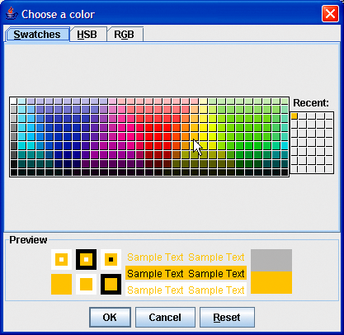
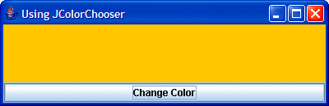
Select a color from one of the color swatches.

Slide 24
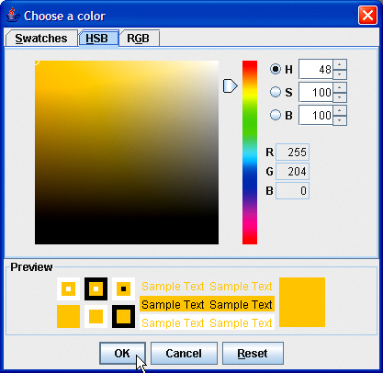
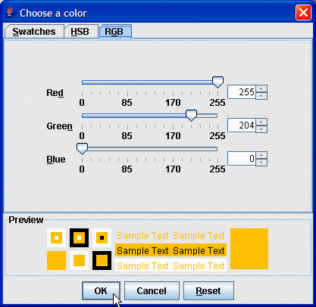
Fig. 12.9 | HSB and RGB tabs of the JColorChooser dialog.
Sliders to select the red, green and blue color components

Slide 25
12.4 Font Control
Class Font
Constructor takes three arguments—the font name, font style and font size
Font name – any font currently supported by the system on which the program is running
Font style –Font.PLAIN, Font.ITALIC or Font.BOLD. Font styles can be used in combination
Font sizes – measured in points. A point is 1/72 of an inch.
Methods getName, getStyle and getSize retrieve information about Font object
Graphics methods getFont and setFont retrieve and set the current font, respectively

Slide 26
Fig. 12.10 | Font-related methods and constants. (Part 1 of 2)

Slide 27
Fig. 12.10 | Font-related methods and constants. (Part 2 of 2)

Slide 28
Portability Tip 12.2
The number of fonts varies greatly across systems. Java provides five logical font names—Serif, Monospaced, SansSerif, Dialog and DialogInput—that can be used on all Java platforms. The Java runtime environment (JRE) on each platform maps these logical font names to actual fonts installed on the platform. The actual fonts used may vary by platform.

Slide 29
Font name
Font style
Font size
Creating and setting Font objects

Slide 30
Combining styles
Retrieve font name and size of Graphics object’s current Font

Slide 31
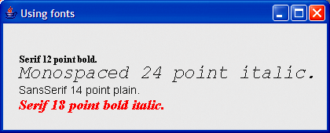

Slide 32
Software Engineering Observation 12.2
To change the font, you must create a new Font object. Font objects are immutable—class Font has no set methods to change the characteristics of the current font.

Slide 33
Font Metrics
Font class methods
getFamily – returns name of font family to which the current font belongs
isPlain, isBold, isItalic – used to determine font style
Font metrics – precise information about a font
Height
Descent – amount a character dips below the baseline
Ascent – amount a character rises above the baseline
Leading – the interline spacing
Class FontMetrics declares several methods for obtaining font metrics

Slide 34
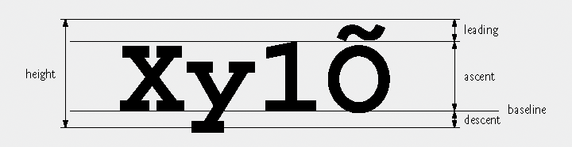
Fig. 12.13 | Font metrics.

Slide 35
Fig. 12.14 | FontMetrics and Graphics methods for obtaining font metrics.

Slide 36
Retrieve FontMetrics object of current Font
Retrieve font metric values

Slide 38
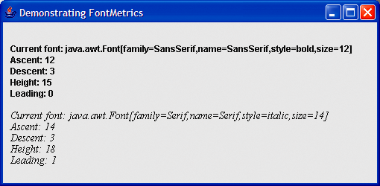

Slide 39
12.5 Drawing Lines, Rectangles and Ovals
Graphics methods for drawing lines, rectangles and ovals
fillRoundRect and drawRoundRect – draw rectangles with rounded corners
bounding rectangle—the area in which a rounded rectangle or oval will be drawn
draw3DRect and fill3DRect – draw a 3D rectangle that is either raised or lowered
drawOval and fillOval – draw ovals

Slide 40
Fig. 12.17 | Graphics methods that draw lines, rectangles and ovals. (Part 1 of 2)

Slide 41
Fig. 12.17 | Graphics methods that draw lines, rectangles and ovals. (Part 2 of 2)

Slide 42
Draw a straight line
Draw an empty rectangle
Draw a filled rectangle

Slide 43
Draw a filled rectangle with rounded corners
Draw an empty rectangle with rounded corners
Draw an empty rectangle that is raised
Draw a filled rectangle that is lowered
Draw an empty oval
Draw a filled oval

Slide 45
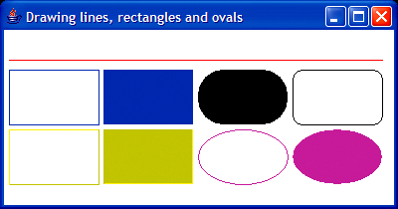
fillRoundRect
drawLine
drawRoundRect
drawRect
drawOval
fillRect
fillOval
draw3DRect
fill3DRect

Slide 46

Fig. 12.20 | Arc width and arc height for rounded rectangles.

Slide 47

Fig. 12.21 | Oval bounded by a rectangle.

